Slide 1

Battle of the Neighborhoods
The best district to open a restaurant in Toronto
By Jasmine Li

Slide 2
Introduction
Data Preparation
CONTENTS
Data Analysis
Results and Conclusion

Slide 3
Introduction
The idea of this study is to help people planning to open a new restaurant in Toronto to choose the right location by providing data about the income and population of each neighborhood.

Slide 4
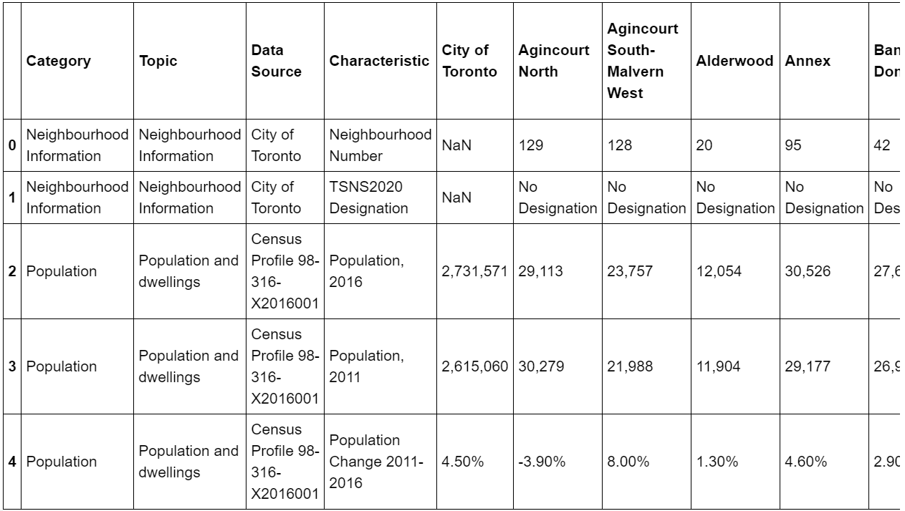
Data Preparation

Slide 5
Data Analysis
Use the data at hand to do analysis
Main factors to be considered:
Population
Income
Competitors

Slide 6
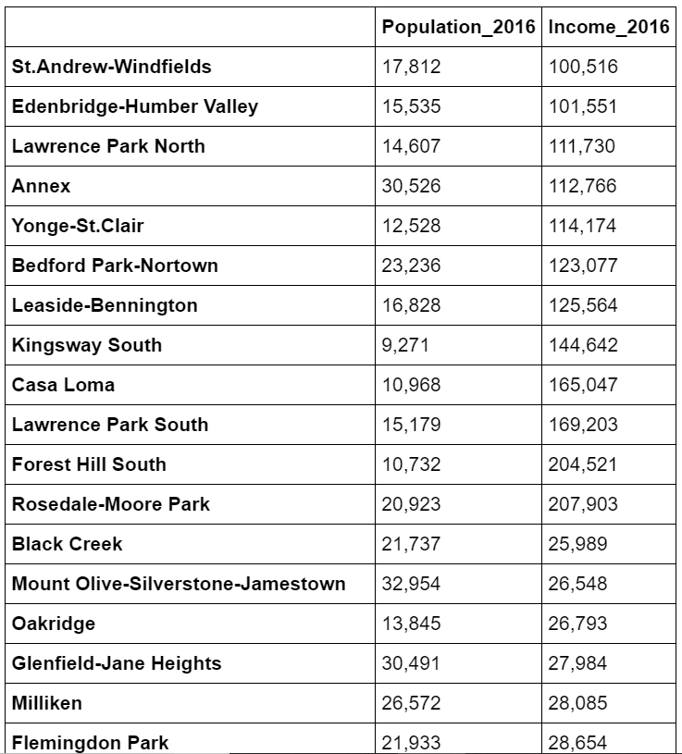
Data Analysis
Cleaned dataset:

Slide 7
Results and Conclusion
Best Districts
Yonge and Eglinton
The Annex
Kensington Market
Queen ST. West

Slide 8
THANK YOU

